Slide 1
Assessing the Least Squares Fit
Part 2
BUAN/ MECO 6312
Dr. Moran Blueshtein
University of Texas - Dallas

Slide 2
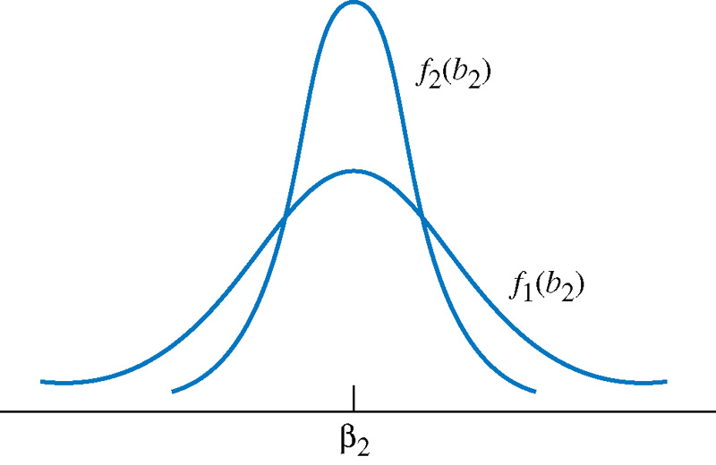
Assessing the Least Squares Fit
Variance
Variance
Estimator 2 is more efficient!

Slide 3
Assessing the Least Squares Fit
Efficiency
Efficiency
If you have two candidate estimators where one estimator has lower variance than the other, you will say that the estimator with the lower variance is more efficient.
When comparing between two candidates for unbiased estimators, we always want to use the one with the smaller variance, since that estimation rule gives us the higher probability of obtaining an estimate that is close to the true parameter value.

Slide 4
Assessing the Least Squares Fit
The Variance of b₂

Slide 5
Assessing the Least Squares Fit
The Variance of b₁
Similarly:

Slide 6
Assessing the Least Squares Fit
MAJOR POINTS ABOUT THE VARIANCE OF b₁ AND b₂
The Variances of b₁ and b₂
The larger the variance term σ² , the greater the uncertainty there is in the statistical model, and the larger the variances of the least squares estimators.
The larger , the smaller the variances of the least squares estimators and the more precisely we can estimate the unknown parameters.
The larger the term , the larger the variance of the least squares estimator b₁ (but note that not b₂ )
The larger the sample size N, the smaller the variances of the least squares estimators. The least squares estimator is thus also a consistent estimator

Slide 7
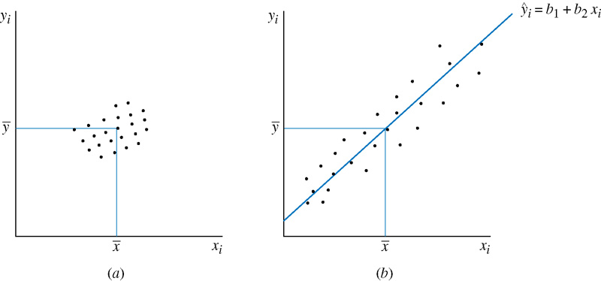
Assessing the Least Squares Fit
The Variances of b₁ and b₂

Slide 8
Assessing the Least Squares Fit
Consistency
Consistency
An estimator is consistent if, as the sample size increases, the estimates (produced by the estimator) "converge" to the true value of the parameter being estimated.
To be slightly more precise - consistency means that, as the sample size increases, the sampling distribution of the estimator becomes increasingly concentrated at the true parameter value.

Slide 9
Assessing the Least Squares Fit
Consistency
Variance of the estimator is decreasing with sample size

Slide 10
Assessing the Least Squares Fit
Consistency VS. Unbiasedness
Consistency Vs. unbiasedness
These two are not equivalent!
Unbiasedness is a statement about the expected value of the sampling distribution of the estimator.
Consistency is a statement about "where the sampling distribution of the estimator is going" as the sample size increases.

Slide 11
Assessing the Least Squares Fit
Consistency VS. Unbiasedness
Consistency Vs. unbiasedness
An Example
Consider a random variable X that is normally distributed N(μ,σ² ).
We can randomly draw from this population to create a sample x1,...,xn
Suppose you're estimating μ.
X1 is an unbiased estimator of μ
since E(X1)=μ
But the variance of X1 is always σ² so it is not consistent.
Similarly there are examples for estimators that are consistent but still biased.

